Slide 1
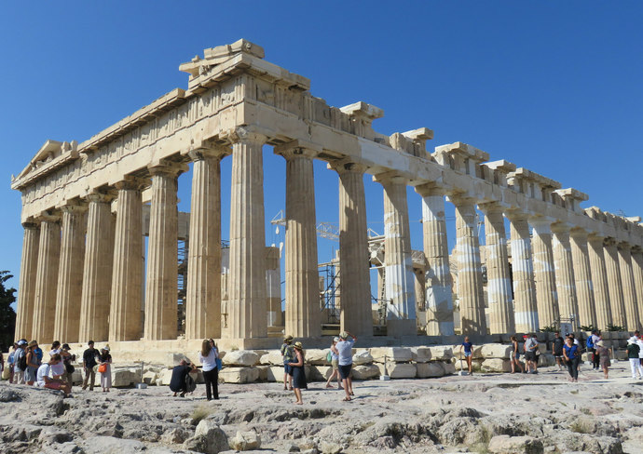

Slide 2
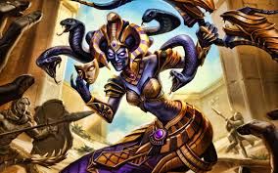
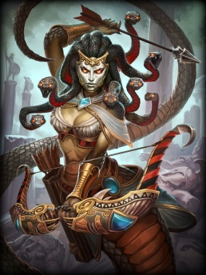
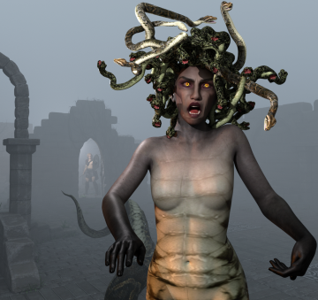
Many stories that are still famous today about heroes and monsters came from Ancient Greece, including the story of Medusa. Medusa was a monster who lived in a cave. She had snakes on her head. When people looked at her, they turned into stone.

Slide 3
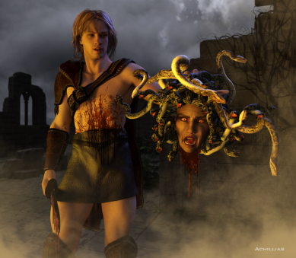
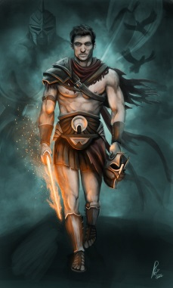
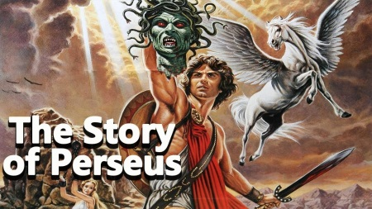
The King sent Perseus, a young man, to find Medusa and kill her. Perseus was very smart.
He went to the cave with a sword and a shield. He didn’t look at Medusa directly. He looked at her reflection in his shield, and he cut off her head with his sword.

Slide 4
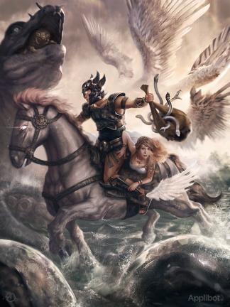
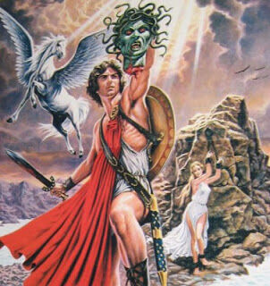
From her neck appeared a beautiful white horse with golden wings called Pegasus.
Perseus returned to the King, riding Pegasus, and took Medusa’s head to him.

